Slide 1

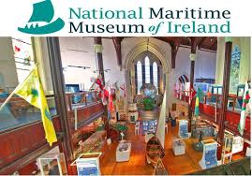
The Maritime Museum Trail
Dun Laoghaire
By
Emer Boyle, Helen Macey and Fiona Duggan
Suitable for Senior Classes
.
Instructions;
Bring a clipboard and pencil
Work in groups of 4 or 6
Be respectful of other visitors to the museum.
Enjoy!
Start
Blackrock Education Centre
tt
tt

Slide 2

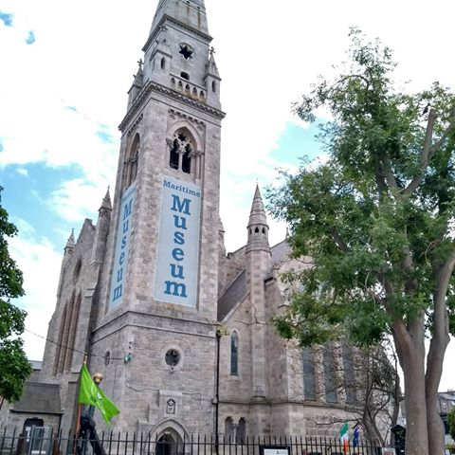

The Building
Stop
1
The Maritime Museum used to be a church called the Mariners Church. It is 100 years old. It became a museum in 1978.
Image related to info
1
Outside: What evidence can you find on the building and in the surroundings to show its Maritime history?___________________________
__________________________________________
Go insidethe building
2
Enjoy lgkndfl;fe woodlands, the magnificent 18
Inside the Building
What evidence can you find to show that this building was once a church?
Stained glass window
Baptismal font
Altar
Wall Plaques
Other__________________________
Look at the large wooden pillars supporting the roof. What would they remind a sailor of?
Go to the stand inside called the Palme.

Slide 3
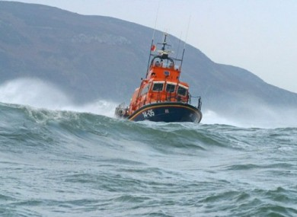
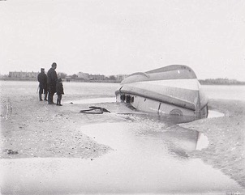
The Palme
Stop
2
The loss of the Palme is also known as the Kingstown tragedy. It was one of the worst tragedies in the history of the RNLI in Ireland
1
When did the Palme sink?_____________________________
2
What happened to the Lifeboat? What do you think self righting means?_______
________________________
3
Study the photo to the right. What thoughts do you think the people in the photo are having?
______________________________________________________________________________________________________________
The capsized lifeboat
Look closely at the model boats. Can you find the model of the Palme?
Move to the R.M.S. Leinster stand .

Slide 4
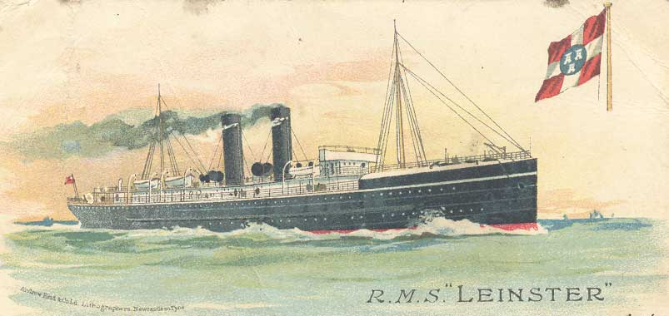
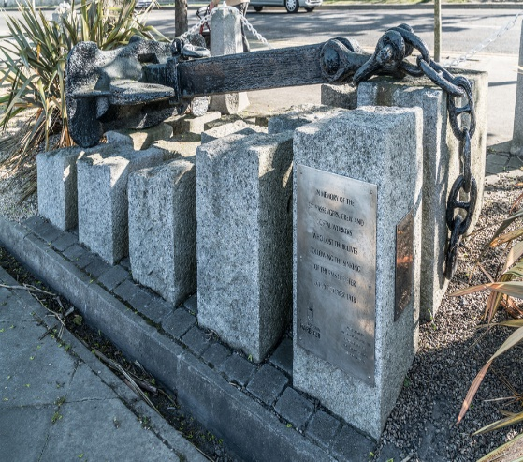
R.M.S. Leinster
Stop
3
The centenary of R.M.S. Leinster is being commemorated in The Maritime Museum throughout 2018.
1
What was the R.M.S. Leinster used for?__________________
__________________________________________________
2
The R.M.S. Leinster was sunk in October 1918. During which war did this occur?_________________
Ck
3
Over 500 people were killed. How many survivors were there?___
Locate and name two survivors_______________
______________________
______________________
Why do you think these people survived?_______
_____________________
_____________________
The anchor of the R.M.S Leinster in Dun Laoghaire
RRRRtTHLL
4
Turn left and head to the Great Eastern stop.
The model of the R.M.S. Leinster has an unusual feature. Can you spot what it is.

Slide 5
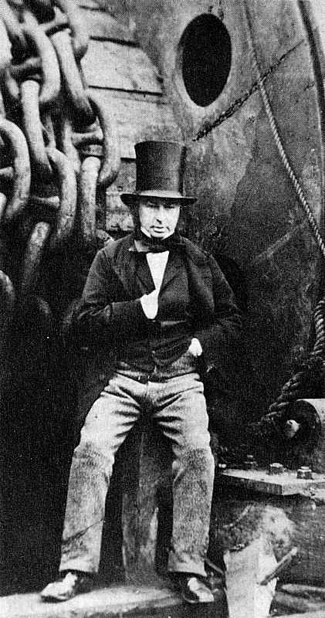
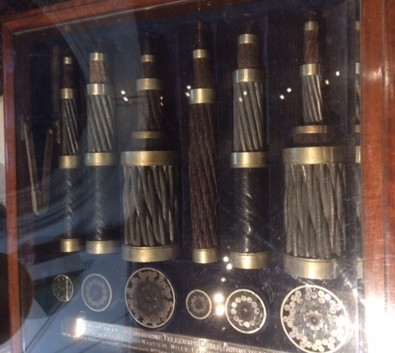
The Great Eastern
Stop
4
The Great Eastern was designed by Isambard Kingdom Brunel. His name for her was Great Babe. Brunel was one of the most famous engineers of his time.
For how long did the Great Eastern hold the title of the Largest Ship in the World?_______________________
1
2
Why do you think it was not a successful ship?___________
________________________
________________________
3
What is the Thursday mast now used for?__________
_____________________
Find the cable box in the photo above .Why do you think these cables are not still in use today?______
__________________________________________
__________________________________________
4
Think about the amazing changes that have occurred in the way we communicate with others, since the time of The Great Eastern.
Move to the front of the museum towards the large light.

Slide 6
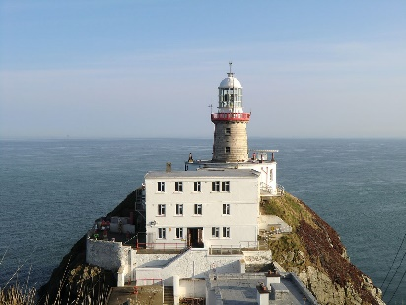
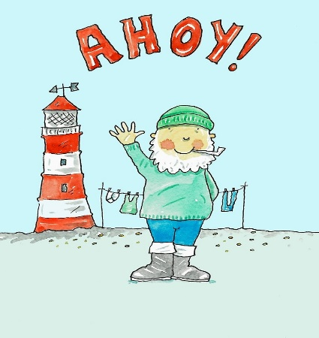
The Optic of the Bailey
Stop
5
There are over 50 lighthouses in Ireland that are maintained and run by the Commissioners of Irish lights. Their Headquarters are in Dun Laoghaire.
The Bailey Lighthouse
1
What is the wattage of the bulb used in the Bailey Lighthouse?__________
2
Find these pictures.
John Richardson Wigham
A lighthouse on a rock
Why do you think lighthouses are so important in Ireland?______________
_______________________________
_______________________________
3
tthTTt
All of the lighthouses in Ireland were once manned. How do you think they are operated today.?________
______________________
4
Imagine the lonely life of the lighthouse keeper. How do you think he passed the time?
5
Ask the attendant to turn on the light for you .
Go back to the main entrance and head upstairs.

Slide 7
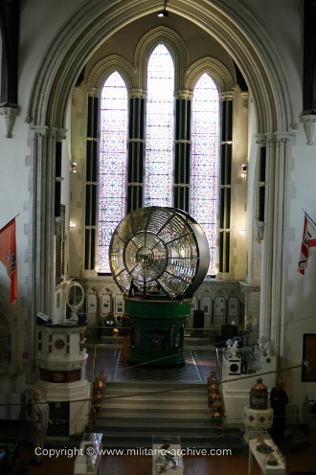
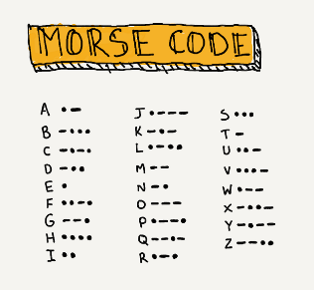
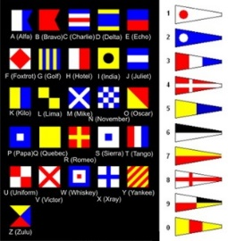
Upstairs at the Maritime
Stop
6
Take a minute to look at the wooden ceiling and the stained glass windows in the building. In pairs explore all the amazing sights to be seen here.
1
Tick the boxes below when you have located the items
.
2 lobster pots
A brown crab
A fishing trawler
The Fenian Ram
A lightbulb from the Titanic
A ship with a local place name
The prisoners dock
A currach
2
Send messages to your friends on the other side of the museum using Morse code or flags.
3
Ask the attendant to turn on the video of the MV Kerlogue for you.
End
Where was the Kerlogue when it rescued the German soldiers?_____
_____________________________
tt
tt

